Slide 1
CostS
Pricing Strategies
2025
Jean-Pierre Dubé
© Copyright 2025

Slide 2
Overview
Pricing is a balancing act: value, costs & competition
This lecture
Delegation of Pricing : accounting/finance vs marketing
Misspecification of pricing objectives
Adverse effects on pricing decisions
Review of costing theory
What firms do in practice? Why?
Identify costs relevant to Pricing
Correct Costing as GROWTH!
day 1
day 3

Slide 3
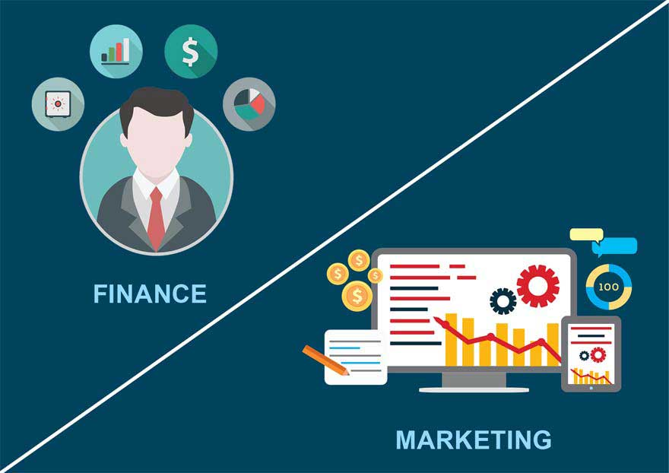
Pricing in the Organization Delegating Pricing Decisions
Pricing should balance customer’s demand for value and firm’s need to cover costs and make profits.
All costs are financially relevant.
But, not all costs are relevant to pricing!

Slide 4


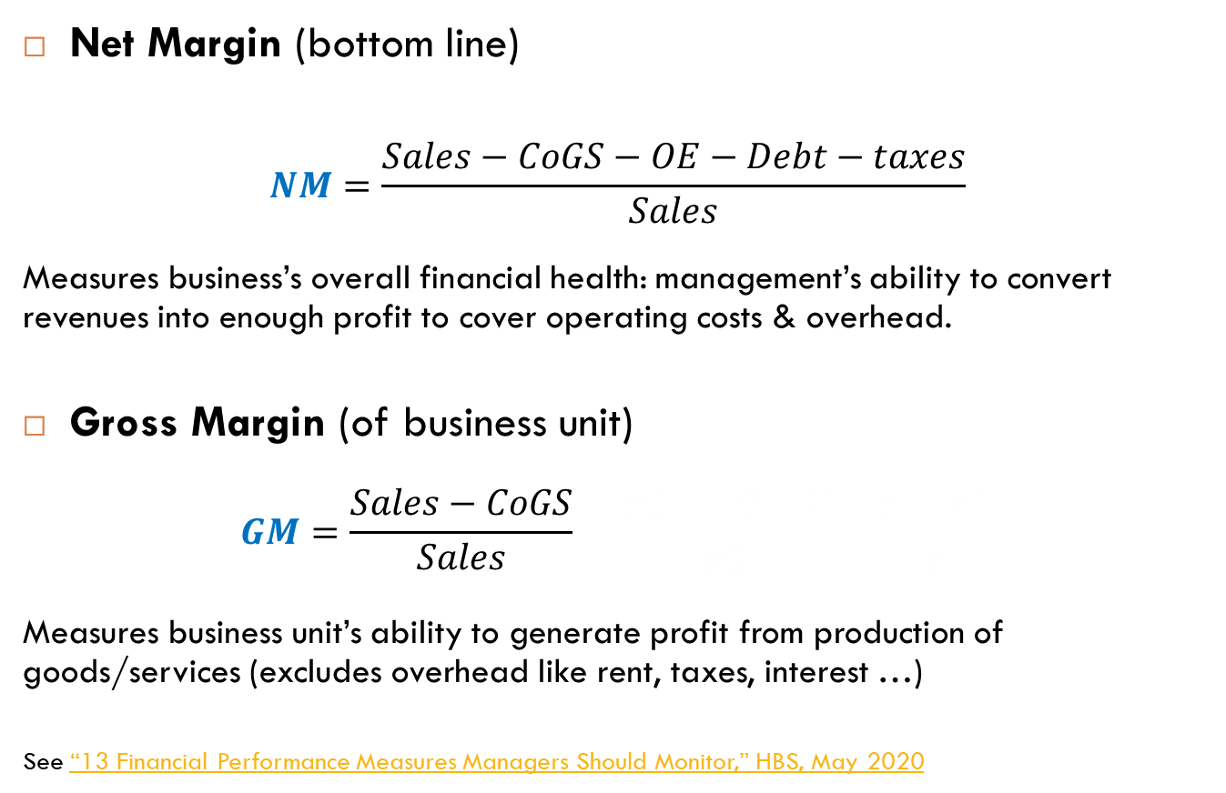
Margins and Financial Performance Finance tracks margins to measure performance
Net Margin (bottom line)
$$NM=\frac{Sales−CoGS−OE−Debt−taxes}{Sales}$$
Measures business’s overall financial health: management’s ability to convert revenues into enough profit to cover operating costs & overhead.
Gross Margin (of business unit)
$$GM=\frac{Sales−CoGS}{Sales}=\frac{pQ−cQ−F}{pQ}=\frac{p−AC}{p}$$
Measures business unit’s ability to generate profit from production of goods/services (excludes overhead like rent, taxes, interest …)
See “13 Financial Performance Measures Managers Should Monitor,” HBS, May 2020
$$net income$$
$$gross income$$
Notes:
CoGS = Cost of Goods Sold = direct production costs (e.g., materials, payroll, inventory, Factory Overhead)

Slide 5

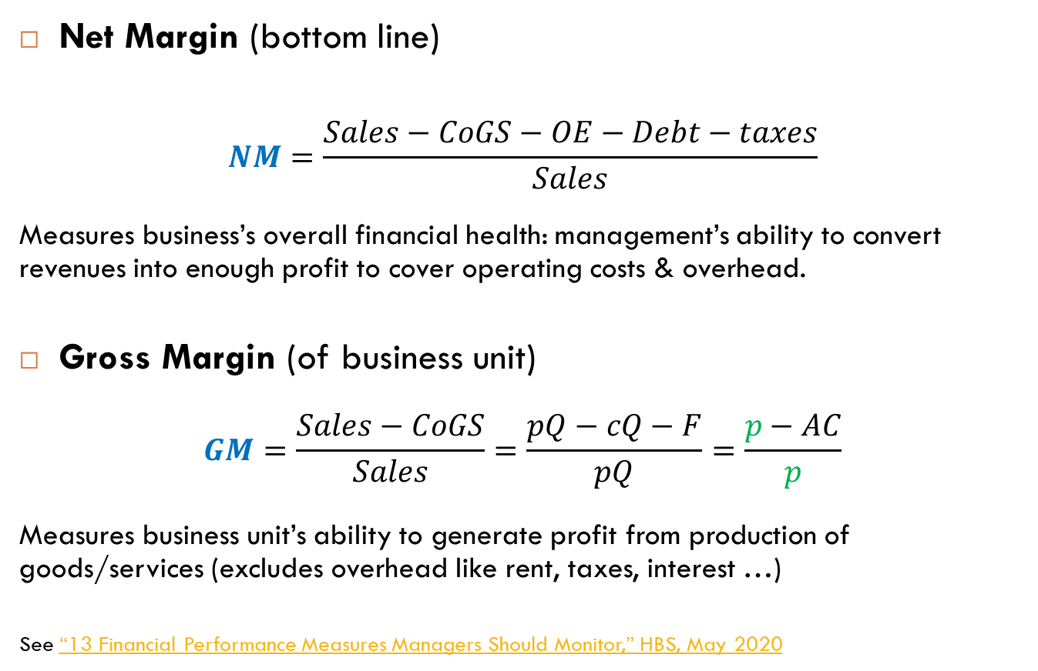
Margins and Financial Performance Finance tracks margins to measure performance
Net Margin (bottom line)
$$NM=\frac{Sales−CoGS−OE−Debt−taxes}{Sales}$$
Measures business’s overall financial health: management’s ability to convert revenues into enough profit to cover operating costs & overhead.
Gross Margin (of business unit)
$$GM=\frac{Sales−CoGS}{Sales}=\frac{pQ−cQ−F}{pQ}=\frac{p−AC}{p}$$
Measures business unit’s ability to generate profit from production of goods/services (excludes overhead like rent, taxes, interest …)
See “13 Financial Performance Measures Managers Should Monitor,” HBS, May 2020
$$net income$$
Direct Fixed Costs
$$AC=c+\frac{F}{Q}$$
$$gross income$$
Notes:
CoGS = Cost of Goods Sold = direct production costs (e.g., materials, payroll, inventory, Factory Overhead)

Slide 6
Fully-Loaded Costing Evidence that firms allocate all costs to prices
 | Shim & Sudit (1995) |  |  | Govindarajan and Anthony (1983)
Pricing Method | Frequency | % |  | Frequency | %
Full Cost | 98 | 69.5 |  | 417 | 82
Variable Cost | 15 | 12.1 |  | 84 | 17
Competitor Pricing | 25 | 17.7
A recent survey of 14,000 European firms: 75% use “full cost pricing”
Altomonte, Barattieri and Basu (2015)
So most companies worldwide are on the spectrum between GM pricing and NM pricing …
So which margin is relevant to pricing?

Slide 7
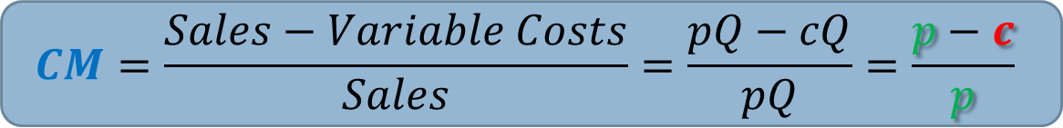
Margins and Financial Performance Finance tracks margins to measure performance
It was a trick question! Typically, neither GM nor NM are appropriate
Some companies use NM. But, it includes all costs across all products/services produced as well as broad operating expenses.
GM uses CoGS, which typically includes fixed factory overhead, inventory, payroll.
Contribution Margin
Measures profit contribution of each unit sold of individual product/service.
Recall the inverse-elasticity rule…
$$CM=\frac{Sales−Variable Costs}{Sales}=\frac{pQ−cQ}{pQ}=\frac{p−c}{p}$$

Slide 8

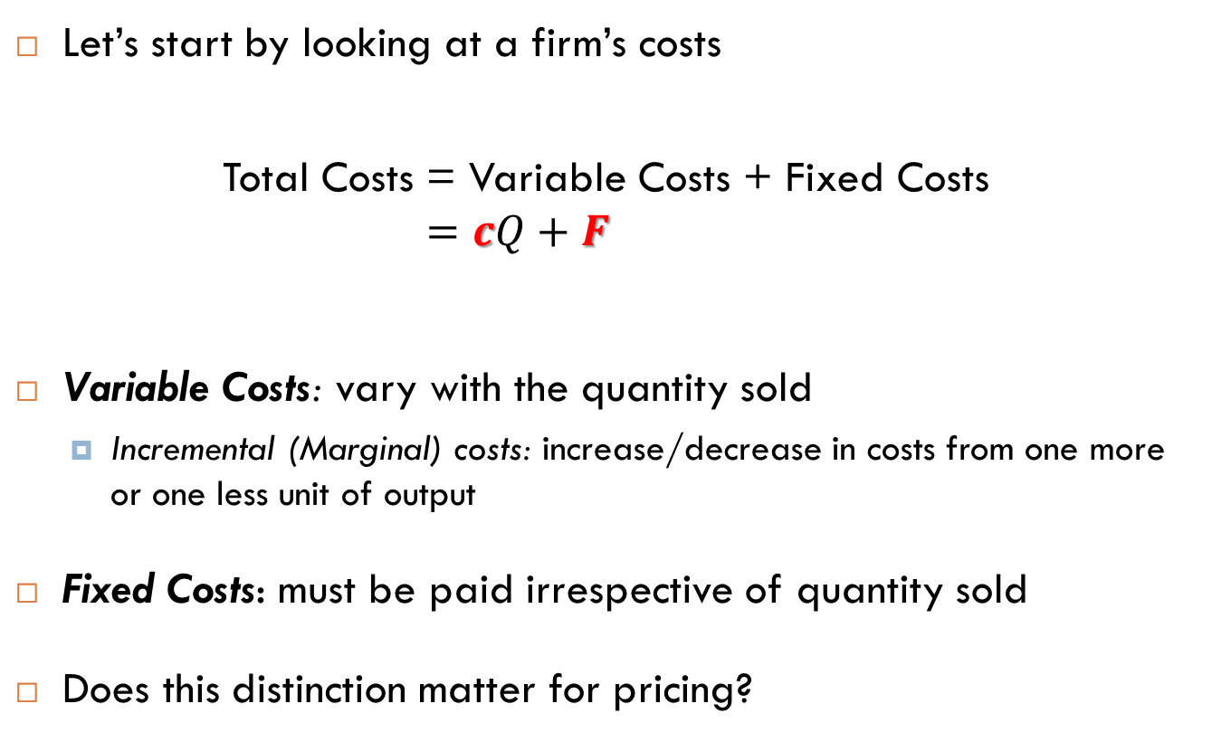

Variable versus Fixed Costs Incremental vs unavoidable costs
Let’s start by looking at a firm’s costs
Total Costs = Variable Costs + Fixed Costs
$$=cQ+F$$
Variable Costs: vary with the quantity sold
Incremental (Marginal) costs: increase/decrease in costs from one more or one less unit of output
Fixed Costs: must be paid irrespective of quantity sold
Does this distinction matter for pricing?
$$marginal cost$$
$$Fixed costs$$

Slide 9
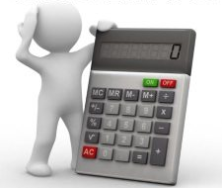
Incremental versus Fixed Costs Fully Allocated Costing
After all, at some point the business has to cover the fixed and the allocated cost - why not use them both for pricing to ensure that this is the case?
This is why many firms price via Gross Margin targets
Should fully allocated unit cost be used for pricing?
i.e., set prices based on Average Costs (versus Marginal Costs)
i.e., mark up price
over AC = c + AFC
vs
over c
Many firms use CoGS
Should use marginal/incremental cost

Slide 10

A Mathematical Argument What’s the pricing objective?
Recall: formal pricing problem sets price $p$to maximize:
$$\left(p−c\right)Q\left(p\right)−F$$
This is the incremental unit (marginal) cost
This is the
total fixed cost
Calculus: F drops out of derivative b/c doesn’t interact with price!
Intuition: price decision cannot help you avoid paying fixed cost F.

Slide 11
A graphical approach to the math Recall the Kone case

Slide 12
A graphical approach to the math Recall the Kone case
Fixed costs don’t
affect optimal
price level!!!
p*

Slide 13
So what about those Fixed Costs? Two-Stage Decision Process
STAGE 1
Decide whether to be in this business
$1 billion to bring new drug to market b/c many failures
(see appendix)
YES
NO
Enter
Do Not Enter / Exit
Incur fixed costs (startup costs)
Do Not Incur Additional Costs
(Fixed or Variable)
Big pharma uses patent law to protect monopoly margins
(see appendix)
STAGE 2
Identify the relevant costs for pricing decision
(e.g., ignore fixed costs)
Short-Run versus Long-Run

Slide 14
Pricing and Marginal costs
Why don’t large, experienced firms always follow this optimization rule?

Slide 15
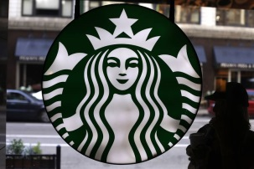
Fully-loaded costing: naïve/opportunistic? Starbucks & local rents
Starbucks Raises Prices Despite Declining Coffee Costs
Coffee purveyor increases average price by about 1% to cover rising wages, rent
By Julie Jargon, WSJ, July 6, 2015
“The Seattle company, like other coffee purveyors, often raises prices for its products when coffee prices increase, but the latest move comes despite a decline of about 42% in Arabica futures prices from a peak late last year.”
Is this naïve, fully-loaded costing?
Is rent rationalizable as an incremental cost?
Is this price opportunism?
(i.e., exploit media buzz about inflation in minimum wage and commercial land values to raises prices without customer fairness backlash)

Slide 16
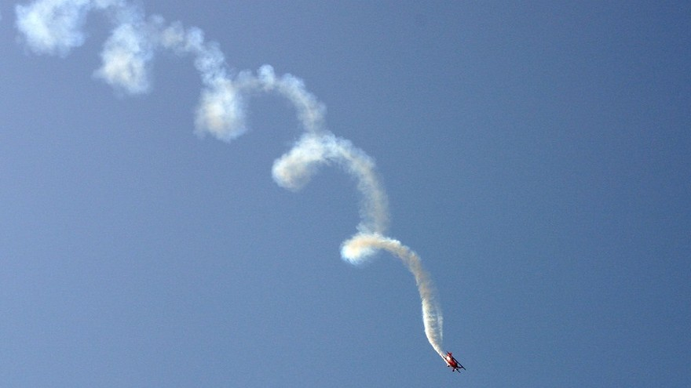

Risks from Fully-Loaded Costs
Impact of GM Pricing (i.e., loading FC changes into pricing):
$$F↑\overset{⇒}{}\frac{F}{Q}↑$$
$$\overset{⇒}{}AC↑$$
$$\overset{⇒}{}GM↓$$
$$\overset{⇒}{}P↑$$
$$\overset{⇒}{}Q↓$$
$$\overset{⇒}{}AC↑$$
$$\overset{⇒}{}P↑$$
$$…$$
The Average Cost
Death Spiral

Slide 17
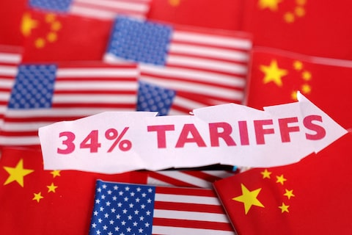
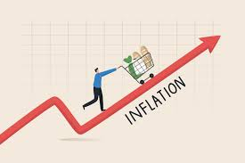
Inflation and now tariffs …

Slide 18

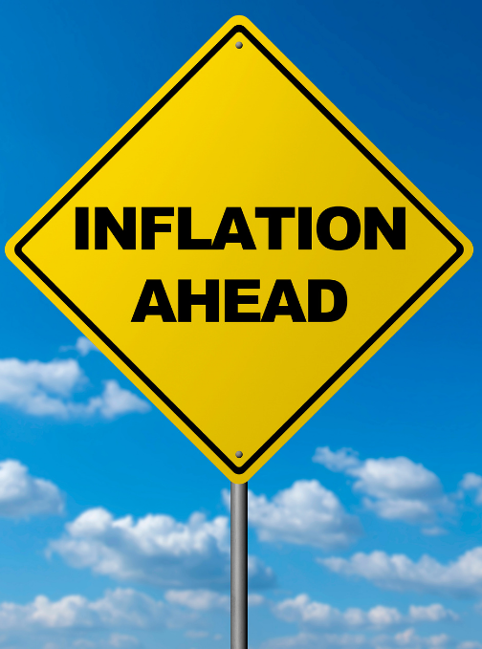
Inflation & variable cost pass-through
Under cost-plus pricing, most companies would pass 100% of variable cost changes through to customers
Many firms tactically react to inflation with ad hoc price increases
This should be a re-optimization problem!
Amount to pass through depends on the shape of demand!

Slide 19
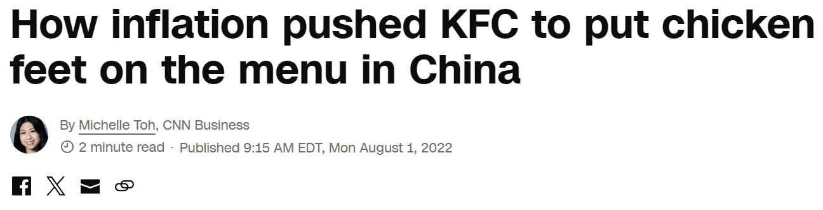
Lessons from recent wave of inflation Pivot when possible
Chinese businesses figured this out two years ago!
“We try to absorb this commodity price increase, with … full utilization of the chicken,” Wat said with a laugh. That means using every part of the chicken, “except the feather, I guess.”
“[Yum China] has also held off from raising prices on meals. Instead, it’s decided to go the other direction: trying to hook more customers with better deals.”

Slide 20
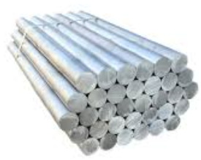
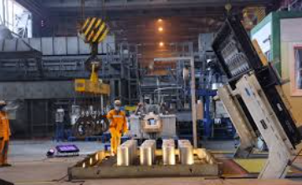
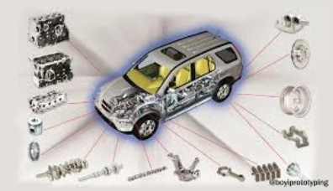
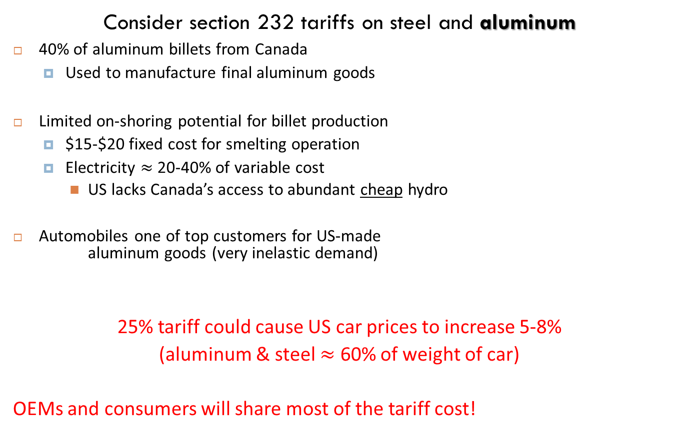
Tariffs & variable cost pass-through Pivots may be difficult
Consider section 232 tariffs on steel and aluminum
40% of aluminum billets from Canada
Used to manufacture final aluminum goods
Limited on-shoring potential for billet production
$15-$20 fixed cost for smelting operation
Electricity $≈$ 20-40% of variable cost
US lacks Canada’s access to abundant cheap hydro
Automobiles one of top customers for US-made
aluminum goods (very inelastic demand)
25% tariff could cause US car prices to increase 5-8%
(aluminum & steel $≈$ 60% of weight of car)
OEMs and consumers will share most of the tariff cost!

Slide 21
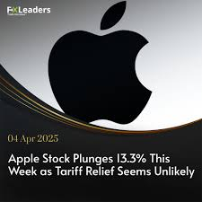
Tariffs & variable cost pass-through Pivots may be difficult
“Vietnam, where the company now makes some AirPods, iPads, Apple Watches and Macs, will be hit with a 46% levy.”
“Daniel Ives, a managing director at Wedbush Securities, said that it would take Apple three years and $30 billion to move just 10% of its supply chain from Asia to the U.S. Plus, the iPhone’s price tag would grow to $3,500, he estimated.”
Source: “Apple iPhone Price Hikes Are Now Looking Possible in the US,” By Mark Gurman, Bloomberg, 04-06-2025.
Source: “‘Nowhere to hide.’ How Apple and others in Silicon Valley are bracing for Trump tariffs,” By Queenie Wong and Wendy Lee, LA Times, 04-05-2025
Rosenblatt Securities: 43% price increase for iPhones and Apple Watches
Scholar Financial Advising: 10% increase for Apple product prices
Morgan Stanley: 17% to 18% price increase across Apple’s product lines in the U.S
Expert predictions are all over the place on this one!

Slide 22
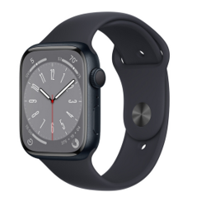

Tariff pass-through at Apple
Market simulation of effects of inflation on prices
Based on conjoint estimates of demand for the Apple Smartwatch Series 8
See “extra” slides for details

Slide 23
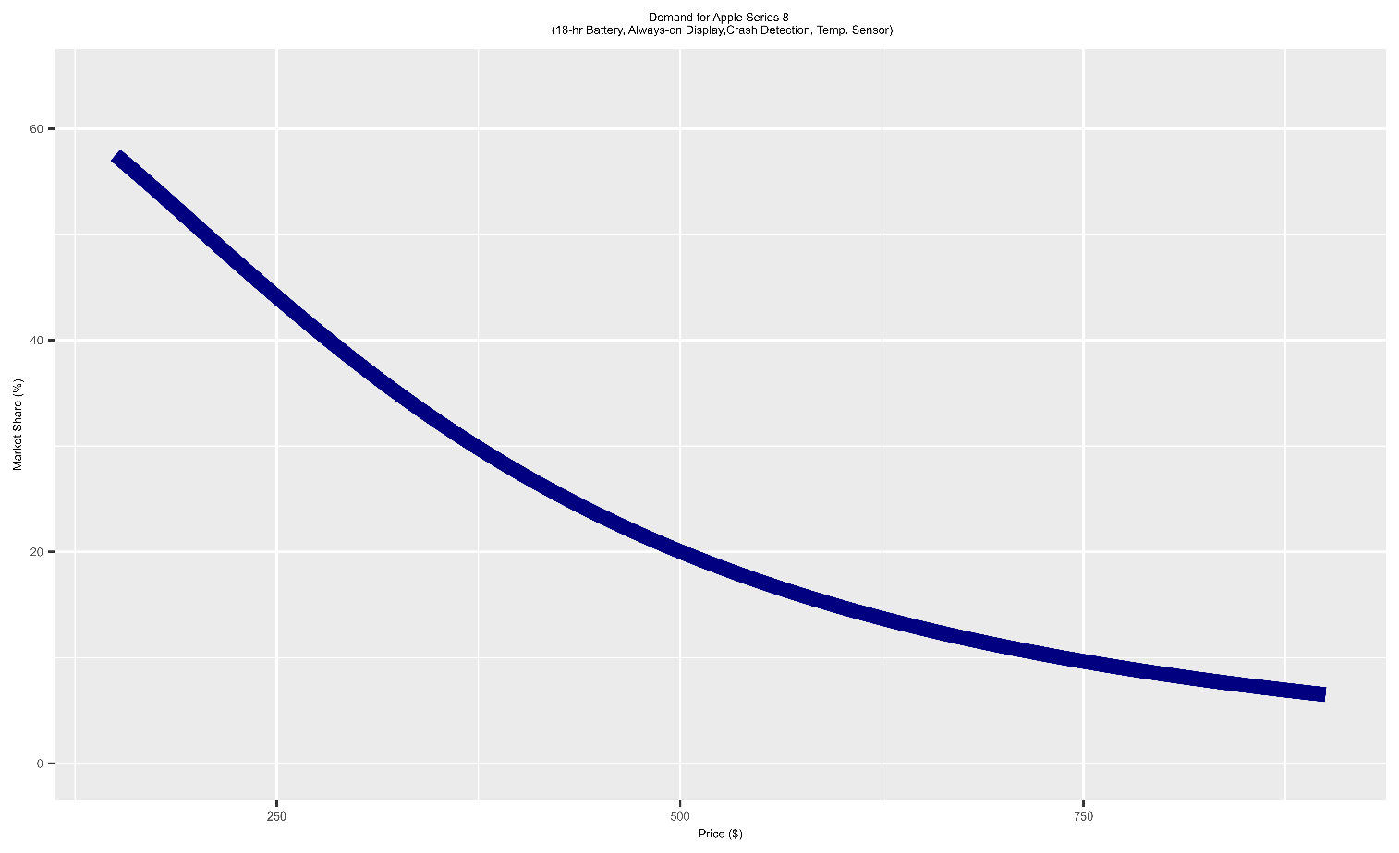
Cost pass-through at Apple Estimated Demand
Demand based on competing Fitbit & Samsung watches

Slide 24
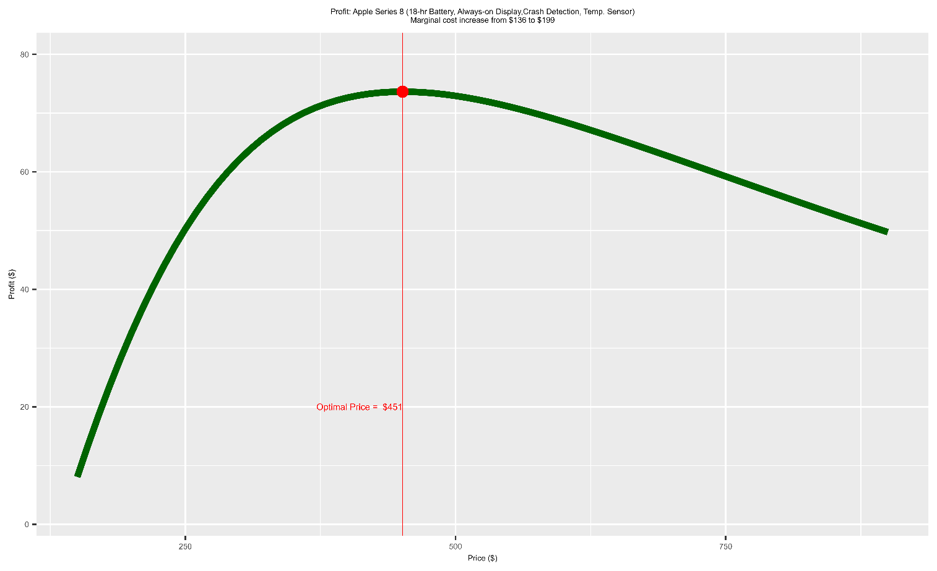
Cost pass-through at Apple Profit & pricing
Marginal cost: $136
New marginal cost: $163
Assume
Apple, Samsung & Fitbit are all exposed to the 46% tariff, driving costs up to $199
Samsung & Fitbit pass through the entire tariff

Slide 25
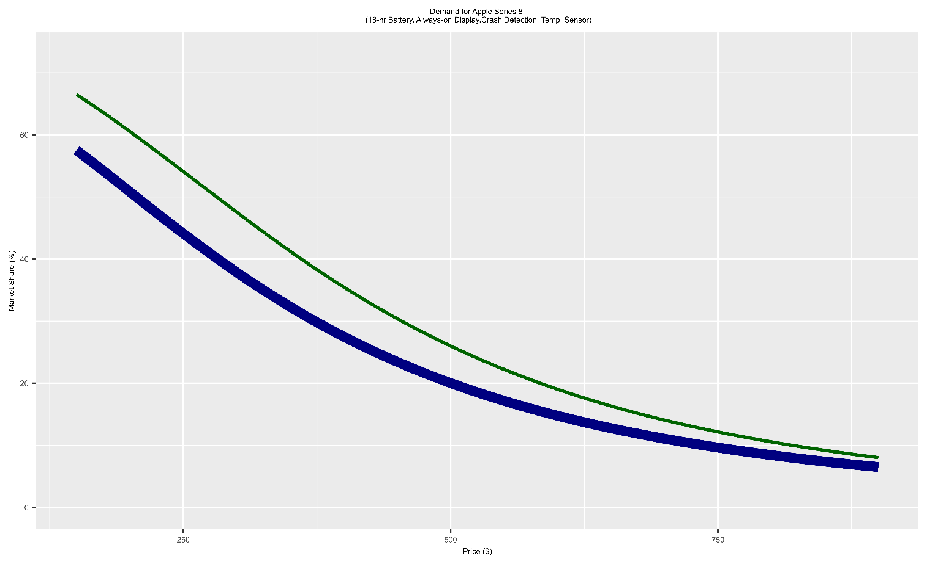
Cost pass-through at Apple Demand Shift due to competitor pass-through
Demand shifts
due to competitor
price changes
Assume
Apple, Samsung & Fitbit are all exposed to the 46% tariff, driving costs up to $199
Samsung & Fitbit pass through the entire tariff

Slide 26
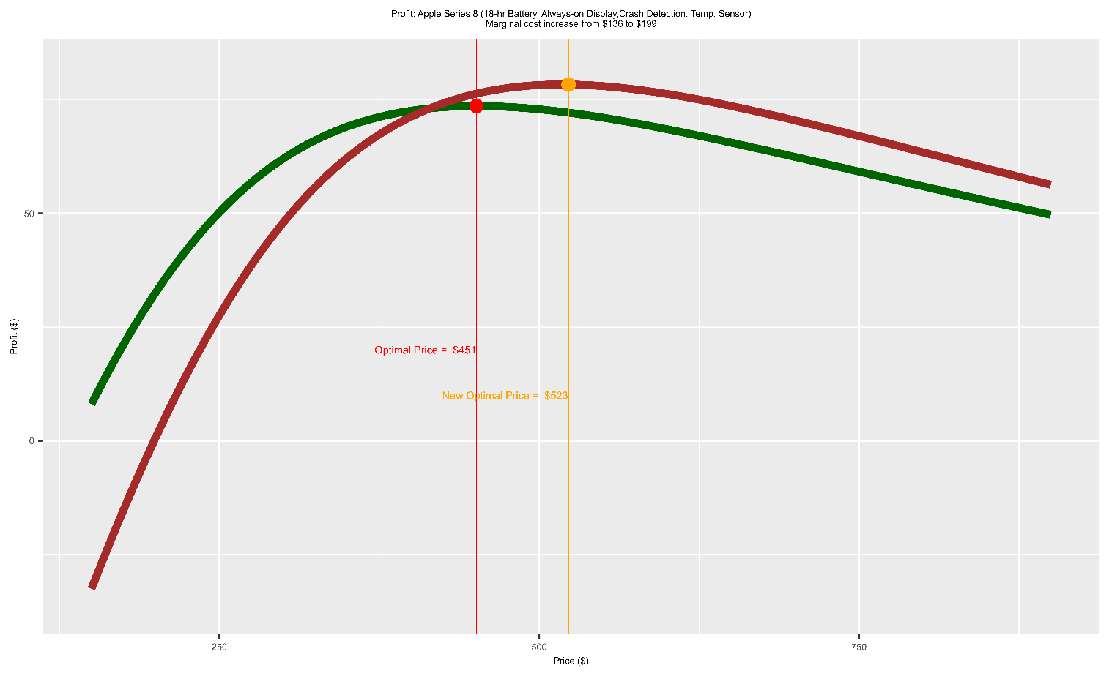
Cost pass-through at Apple Profit & pricing
Apple optimally passes through 113% of cost change! (16% price increase)
Marginal cost: $136
Post-tariff
marginal cost: $199
Assume
Apple, Samsung & Fitbit are all exposed to the 46% tariff, driving costs up to $199
Samsung & Fitbit pass through the entire tariff

Slide 27
Tariffs & variable cost pass-through
So cost pass-through depends on:
Shape of your demand curve
Extent to which cost increases affect competitors and whether competitors also pass these increases through to customers
“optimal” pass-through rate is solution to re-optimization problem!
In a competitive market, it may also require strategic considerations about market “equilibrium” (see next lecture)
1
2

Slide 28
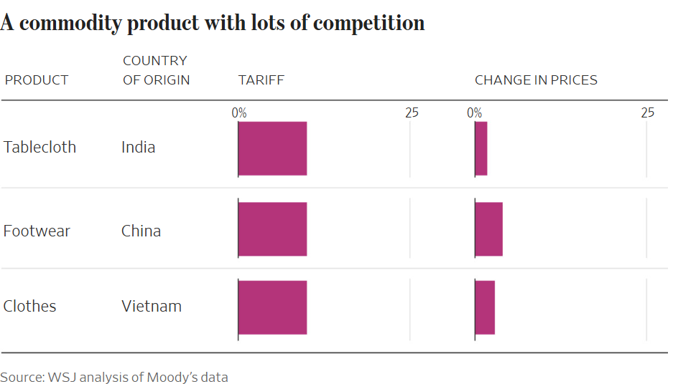
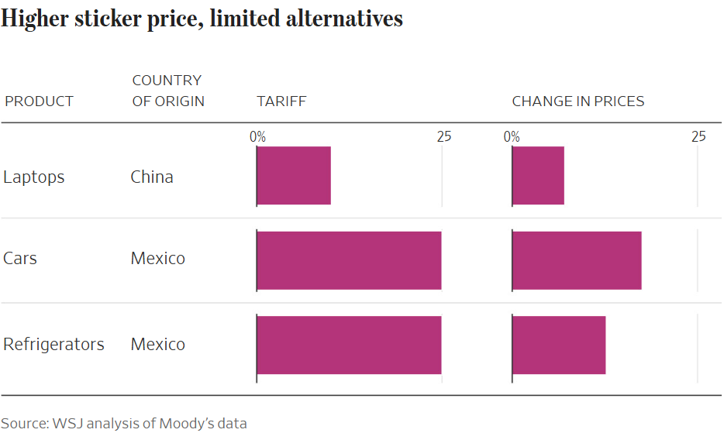
Tariffs & variable cost pass-through Business-to-consumer
Tariffs pass-through complexities:
direct effect on goods from affected countries; &
indirect effect from unaffected competitors
Differential tariff effects across industries
Source: “How Much Do Tariffs Raise Prices?” Douglas et al, WSJ, 03/02/2025

Slide 29
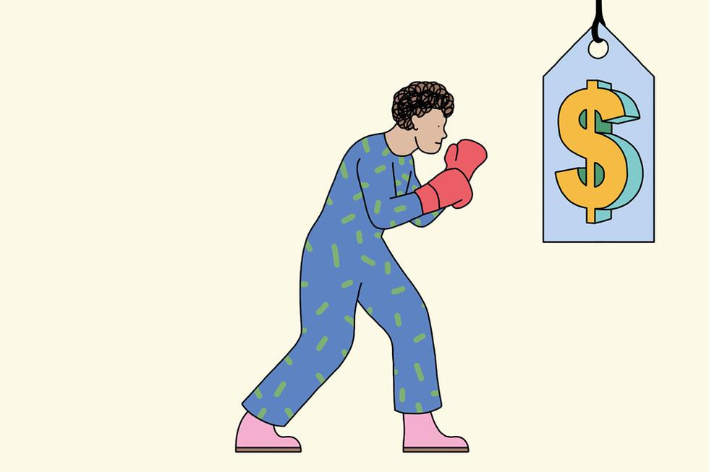
Cost pass-through & Marketing For Good

Slide 30
Prices, costs & marketing for good? Shrinkflation & consumer inattention
“The Hidden Ways Companies Raise Prices”
Gasparo and Rubin, WSJ, Feb. 12 2022
Marginal cost inflation in 2021/2022 should cause higher prices
But many companies are obfuscating price hikes
Hidden fees at resorts, restaurants and retail
Deteriorated service (e.g., hotels only clean sheets at end of stay, no free shuttles for resorts)
Smaller pack sizes (shrinkflation)
Firms are taxing consumer inattention!

Slide 31
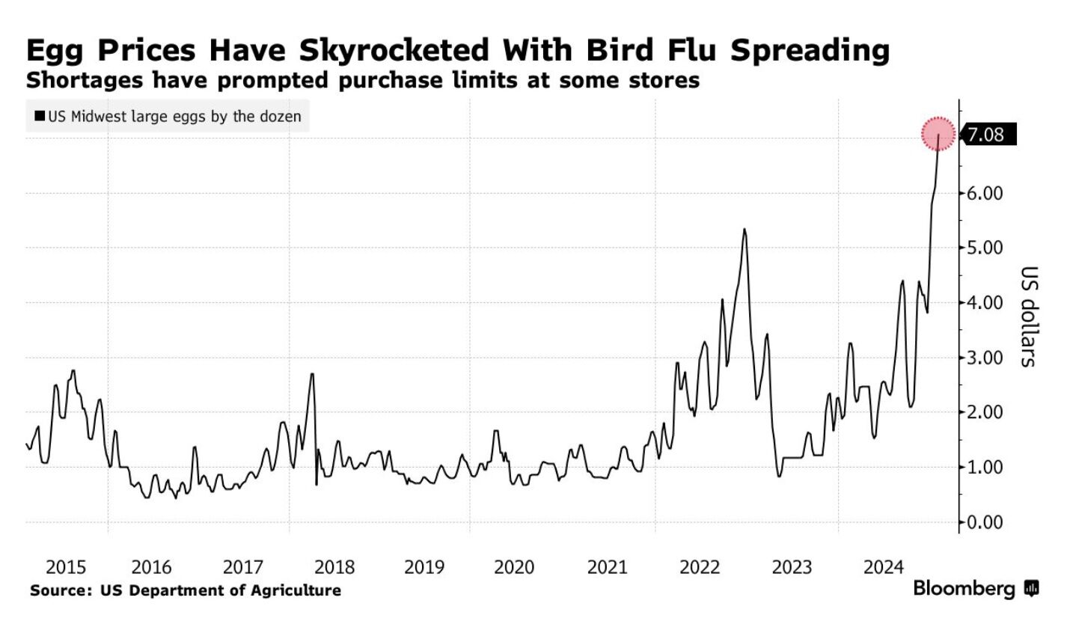
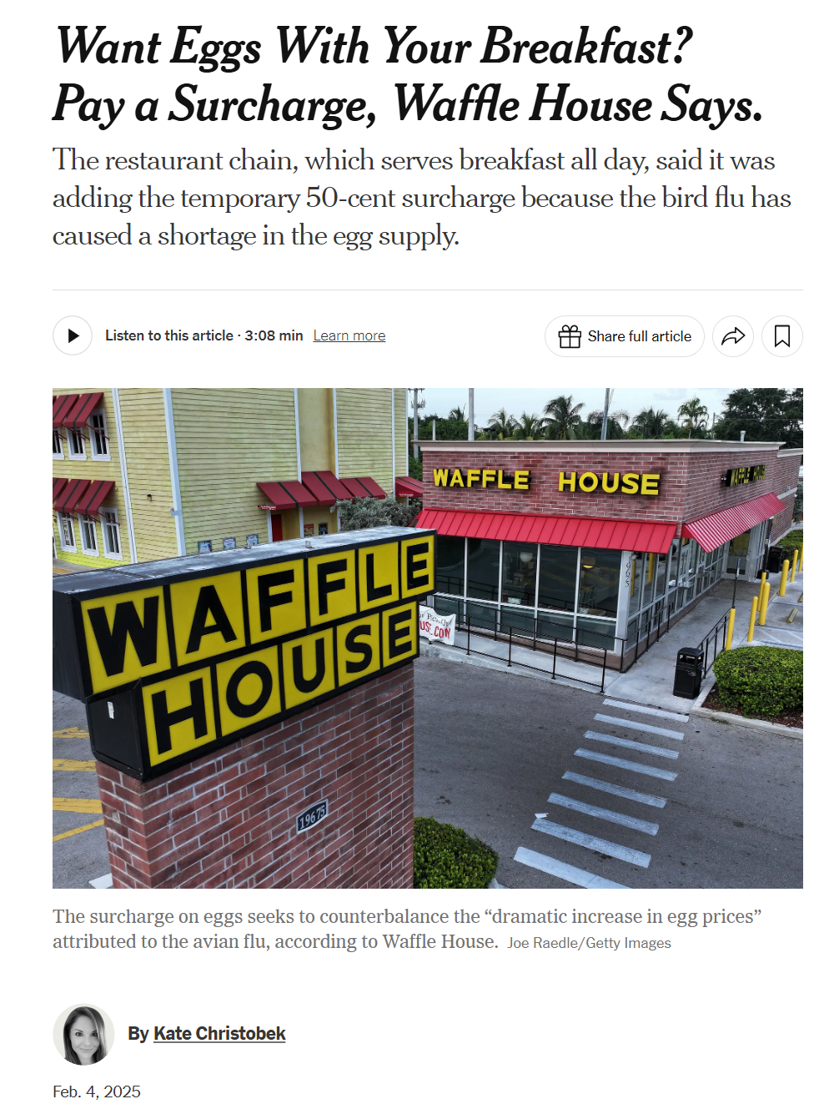
Prices, costs & marketing for good? Shrinkflation & consumer inattention
Wait a minute …
egg prices up $0.24/egg:
$0.35/egg (Dec ‘24) vs $0.59/egg (Feb ‘25)
That's a big increase
BUT, passing through 208% of cost increase to consumers??!!
Math Tax!

Slide 32
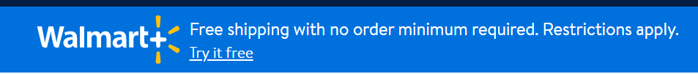
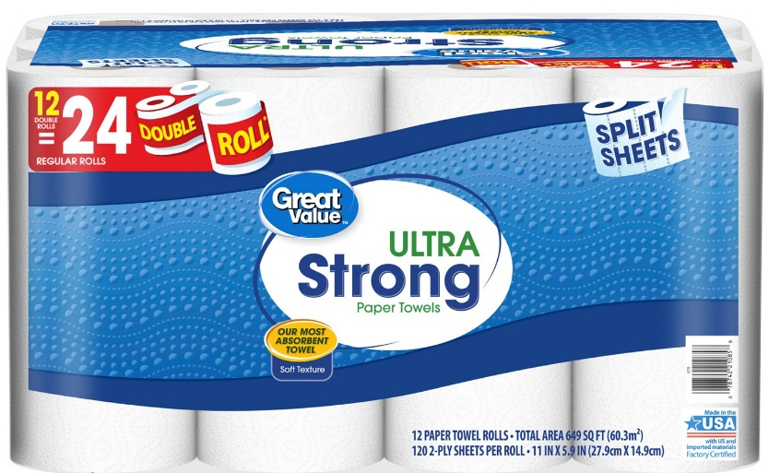
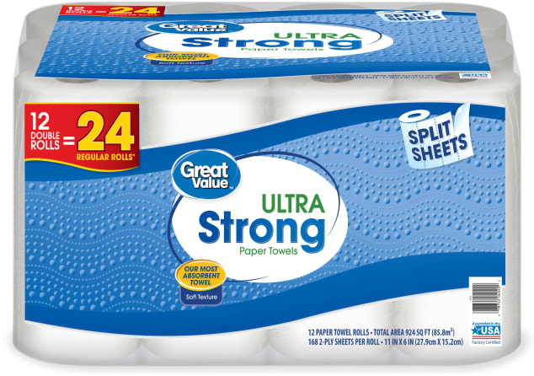
Prices, costs & marketing for good? Shrinkflation & consumer inattention
One way companies are concealing higher prices: Smaller packages
"Consumers check the price every time they buy, but they don't check the net weight. When the price of raw materials, like coffee beans or paper pulp goes up, manufacturers are faced with a choice: Do we raise the price knowing consumers will see it and grumble about it? Or do we give them a little bit less and accomplish the same thing? Often it's easier to do the latter."
By Abha Bhattarai, Washington Post, June 1, 2021
$14.97
Same price but pack reduced from 168 to 120 ply (30% reduction)
See Appendix for more examples

Slide 33
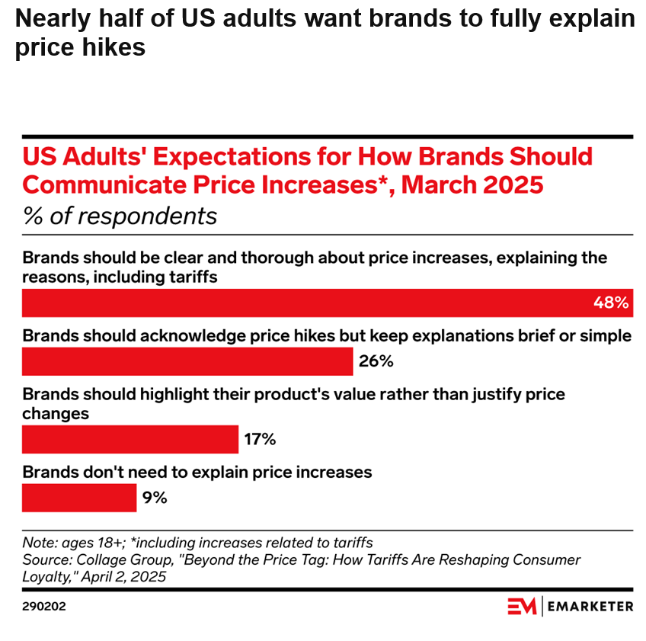
Prices, costs & marketing for good? Transparency demand

Slide 34
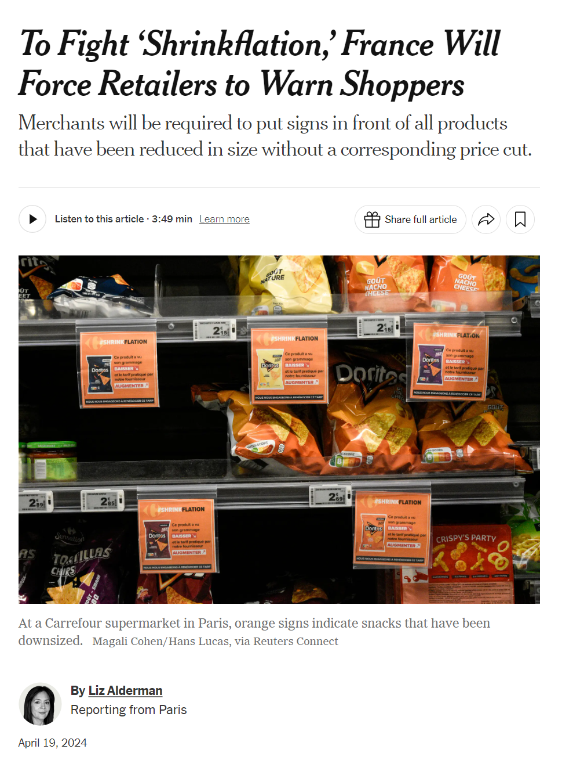
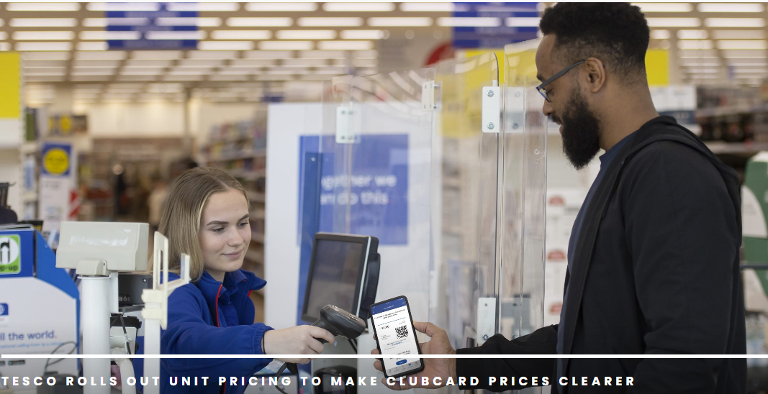

Prices, costs & marketing for good? Transparency Laws & Self-Policing

Slide 35
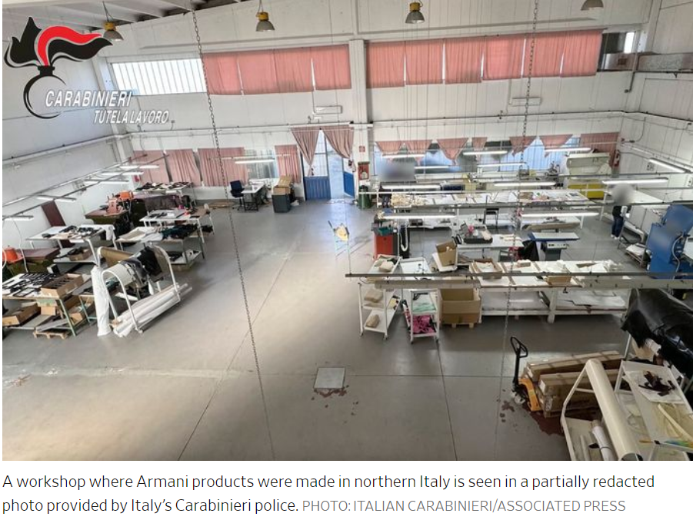
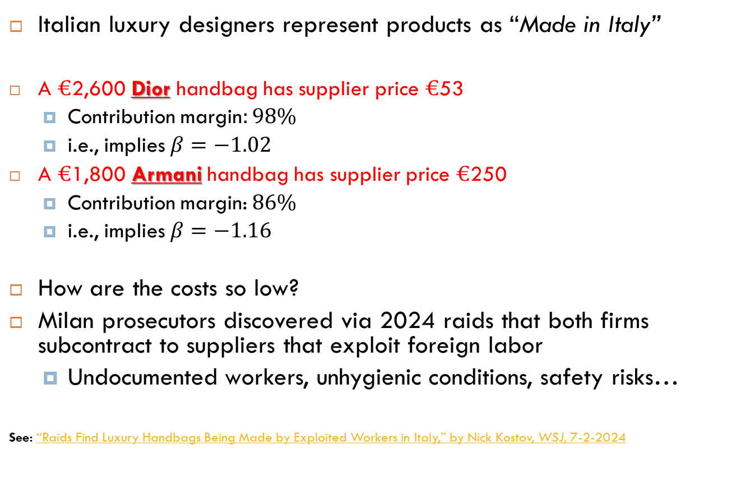
Prices, costs & marketing for good? Litigation, Consumer Protection & slave labor
Italian luxury designers represent products as “Made in Italy”
A $€$2,600 Dior handbag has supplier price $€$53
Contribution margin$:98\%$
i.e., implies $β=−1.02$
A $€$1,800 Armani handbag has supplier price $€$250
Contribution margin: $86\%$
i.e., implies $β=−1.16$
How are the costs so low?
Milan prosecutors discovered via 2024 raids that both firms subcontract to suppliers that exploit foreign labor
Undocumented workers, unhygienic conditions, safety risks…
See: “Raids Find Luxury Handbags Being Made by Exploited Workers in Italy,” by Nick Kostov, WSJ, 7-2-2024

Slide 36
Watch out for historical costs
The cost of a sale includes opportunity cost of the sold units
Opportunity Cost: Next best use of a resource
What you paid in past to acquire a resource is irrelevant.
Focus instead on current alternative uses:
Coffee Beans (reading)
Vintage Bordeaux (reading)

Slide 37
Take Away
Tying Pricing to financial objectives requires careful thinking!
Clearly identify the decision
Identify marginal costs (incremental, avoidable) with respect to this decision.
Set pricing objectives using contribution margin
Opportunistic price increases vs optimization
Hidden cost pass-through is unethical and is causing regulation!
Not all costs are relevant to pricing!

Slide 38
Shrinkflation

Slide 39
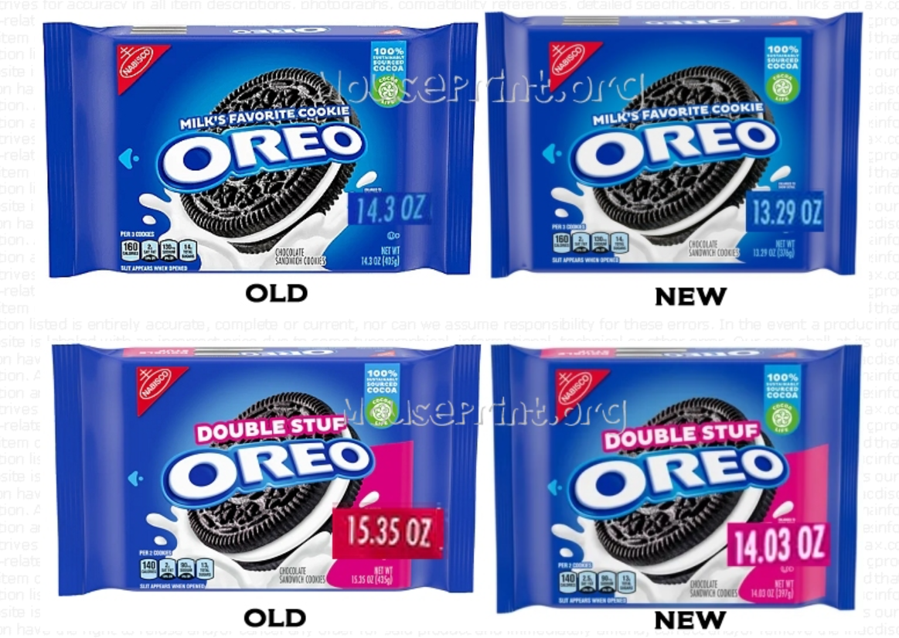
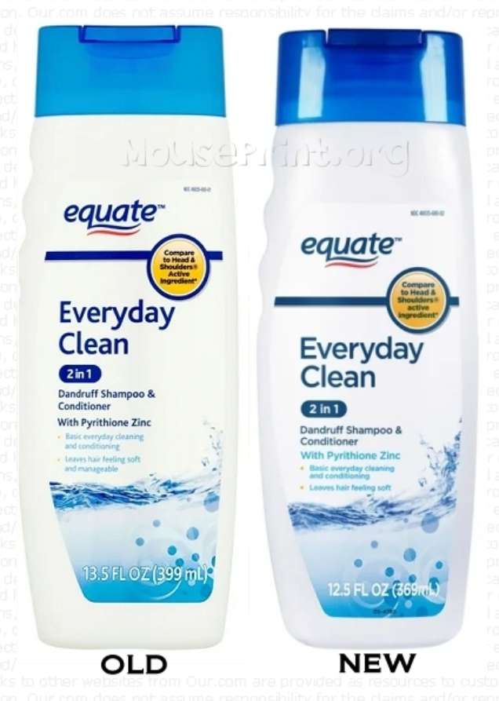
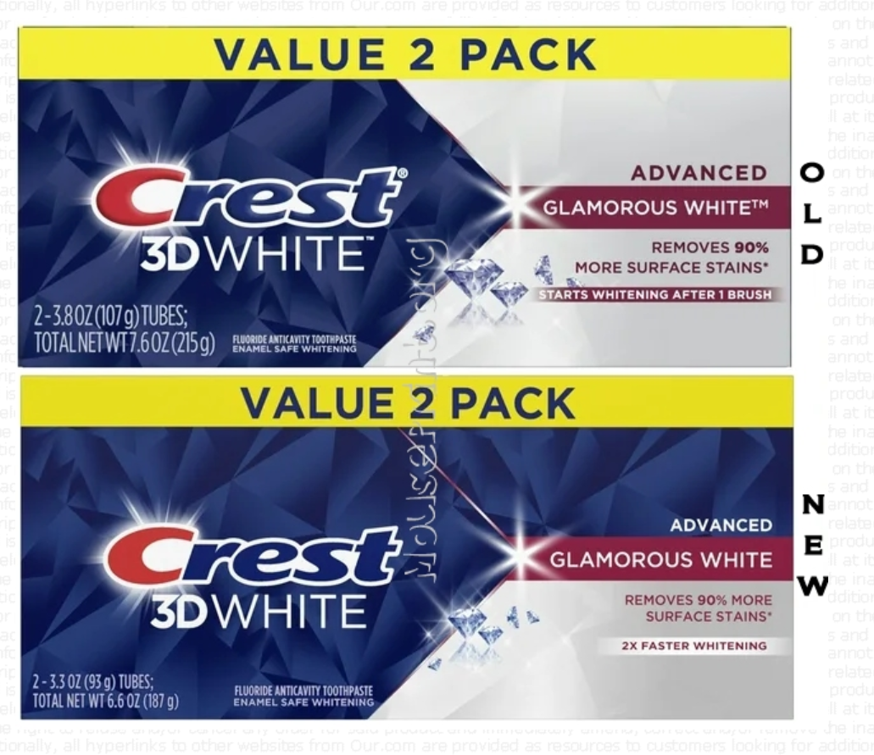
More Examples from 2024

Slide 40
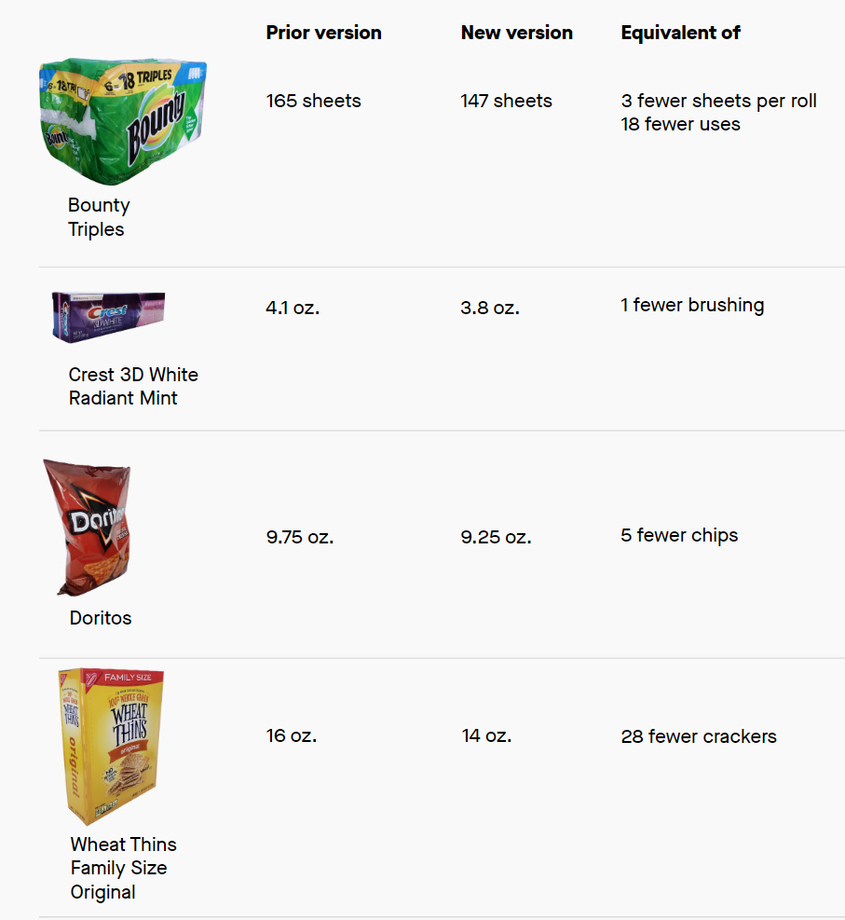
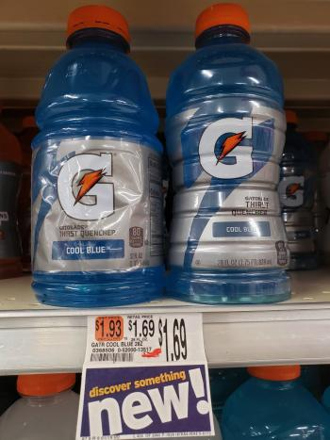
More Examples from 2021
32 oz
28 oz
Equivalent to 14% price increase
“Basically we redesigned the bottle, it’s more aerodynamic and it’s easier to grab,” said a company representative. “The redesign generates a new cost and the bottles are a little bit more expensive…this is only a matter of design.”

Slide 41
Legal vs Ethical
Shrinkflation legal so long as “empty space” in pack is defensible:
E.g., bottle of aspirin needs space for machinery to fill it
New packaging is expensive and might require new machinery (reducing quantity offsets these costs)
McCormick fined $2.5 million for slack-fill in its ground pepper
Ethical issue is whether firms genuinely communicate shrinkflation to consumers, even if downsizing is legal.

Slide 42
Intuition for variable margin logic

Slide 43
Incremental versus Fixed Costs PROJECT XYZ
PRICE OF THE PROJECT $143,000
COMPONENTS OF COST: (All dollar amounts are per hour)
Material $43,200 Direct Labor $ 25.40/h
Labor 415 h Variable Overhead $ 67.90/h
Commission rate 5.0% Fixed Overhead $115.20/h
Engineering hours 83 h Total Burdened Rate $208.50/h
Freight 0.8%
Warranty 1.6% Engineering Rate $ 75.30/h

Slide 44
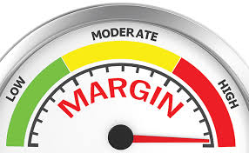
Incremental versus Fixed Costs PROJECT XYZ
CALCULATION OF PROJECT MARGINS
VM GM
Material $43,200 $43,200
Labor $10,541 $10,541
Variable Overhead $28,179 $28,179
Fixed Overhead $47,808
Freight $1,144 $1,144
Warranty $2,288 $2,288
Commission $7,150 $7,150
Engineering $6,250
Total Costs $92,502 $146,559
Margin $50,499 ($3,559)
Margin % 35.3% -2.5%

Slide 45
Incremental versus Fixed Costs PROJECT XYZ
By getting the order, what
will be the contribution
margin?
US$ 50,499
VM logic thinking
How will this job
impact the Firm’s
business?
By getting the
order, the net
contribution
margin will be
US$ 50,499
By not getting the order,
how much will the Firm
spend?
US$ 0

Slide 46
Incremental versus Fixed Costs PROJECT XYZ
By getting the order, what
will be the contribution
margin?
(US$ 3,559)
GM logic thinking
How will this job
impact the Firm’s
business?
By getting the
order, the net
contribution
margin will be
US$ 50,499
By not getting the order,
how much will the Firm
spend?
(US$ 54,058)

Slide 47
Apple Smartwatch
Demand & Monetization with Conjoint Analysis

Slide 48
A Consulting Project for Apple Project Goals
Apple needs to price its new Series 8 smartwatch with
Features:
18 hours battery life
Cellular Service
Always-on
Temperature Sensor
Car Crash Detection

Slide 49
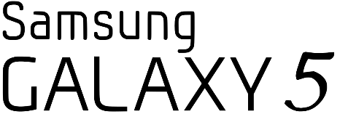

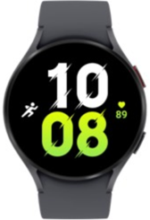
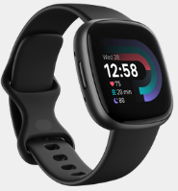
A Consulting Project for Apple Project Goals
But it will face competition in the market:
1 day battery life |  |  |  | 5 days battery life
Cellular Service |  |  |  | Cellular Service
Always-on |  |  |  | Always-on
No Temperature Sensor |  |  |  | Temperature Sensor
No Car Crash Detection |  |  |  | No Car Crash Detection
$ 230
$ 260

Slide 50
Step 1: Study Design Selecting the tested product features
Determine how to describe a Smartwatch in terms of its features:
Examples: 3 possible Smartwatches one could analyze with this design
MODEL I 18 hrs, Cellular, Always-on, Temperature, Apple
MODEL II 3 days, Cellular, Crash, Apple
MODEL III 5 days, Cellular, Always-on, Temperature, Crash, Fitbit
Features | Battery Life | Cellular | Always-on | Temperature Sensor | Car Crash Detection | Brand | Price
Feature Levels | 18 hrs | No | No | No | No | Samsung | $ 249
 | 1 day | Yes | Yes | Yes | Yes | Apple | $ 299
 | 3 days |  |  |  |  | Fitbit | $ 349
 | 5 days |  |  |  |  |  | $ 399

Slide 51

Step 2: A Choice-Based Conjoint Survey

Slide 52

Step 2: A Choice-Based Conjoint Survey

Slide 53

Step 2: A Choice-Based Conjoint Survey

Slide 54
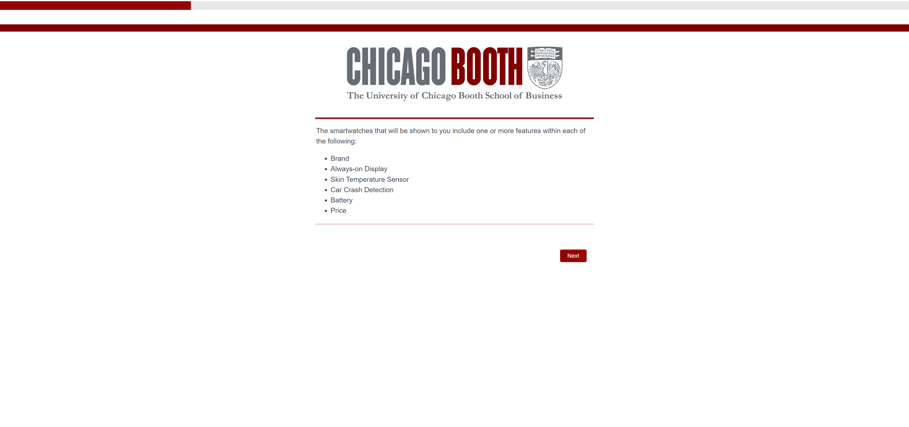
Step 2: A Choice-Based Conjoint Survey

Slide 55

Step 2: A Choice-Based Conjoint Survey

Slide 56

Step 2: A Choice-Based Conjoint Survey

Slide 57

Step 2: A Choice-Based Conjoint Survey

Slide 58

Step 2: A Choice-Based Conjoint Survey

Slide 59
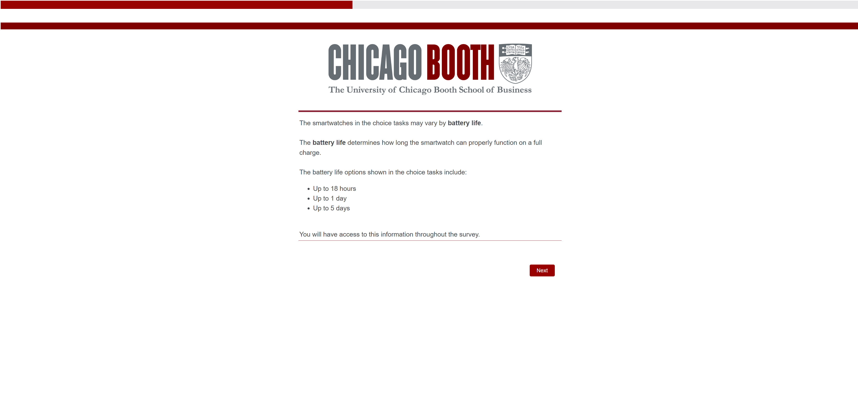
Step 2: A Choice-Based Conjoint Survey

Slide 60
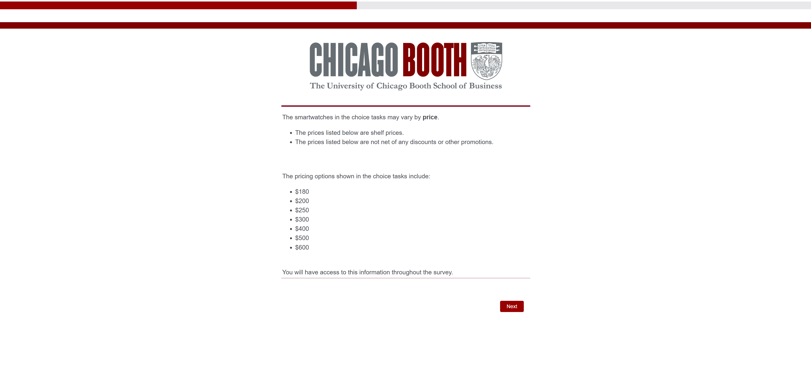
Step 2: A Choice-Based Conjoint Survey

Slide 61

Step 2: A Choice-Based Conjoint Survey

Slide 62
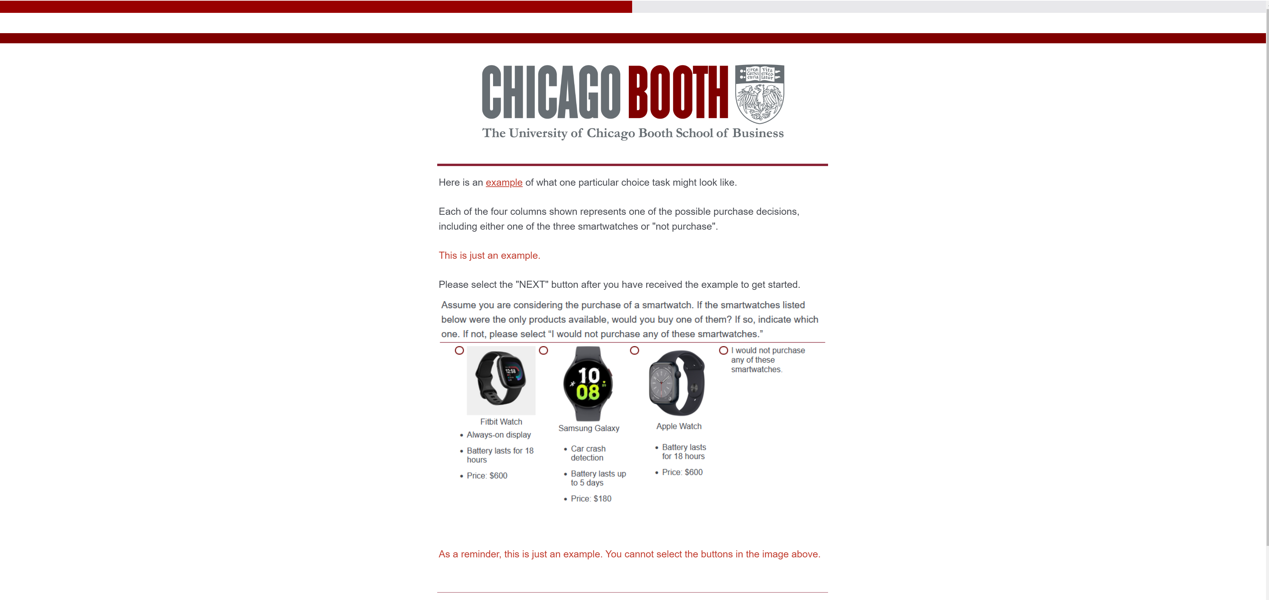
Step 2: A Choice-Based Conjoint Survey

Slide 63

Step 2: A Choice-Based Conjoint Survey

Slide 64
Step 2: A Choice-Based Conjoint Survey
There are 12 choice tasks like the one on the previous slide
Note: in each task the respondent always has the option to choose “I would not purchase any of these smartwatches.”
The data track how a respondent’s choices vary as we force her to trade-off the features of the available watches and the prices.
This is how we learn about willingness-to-pay!

Slide 65
Step 3: Analysis Willingness to pay
I used a hierarchical Bayesian algorithm to estimate a model of demand using the choice data
Let’s see what the data teach us about how much consumers are willing to pay for the various product features

Slide 66
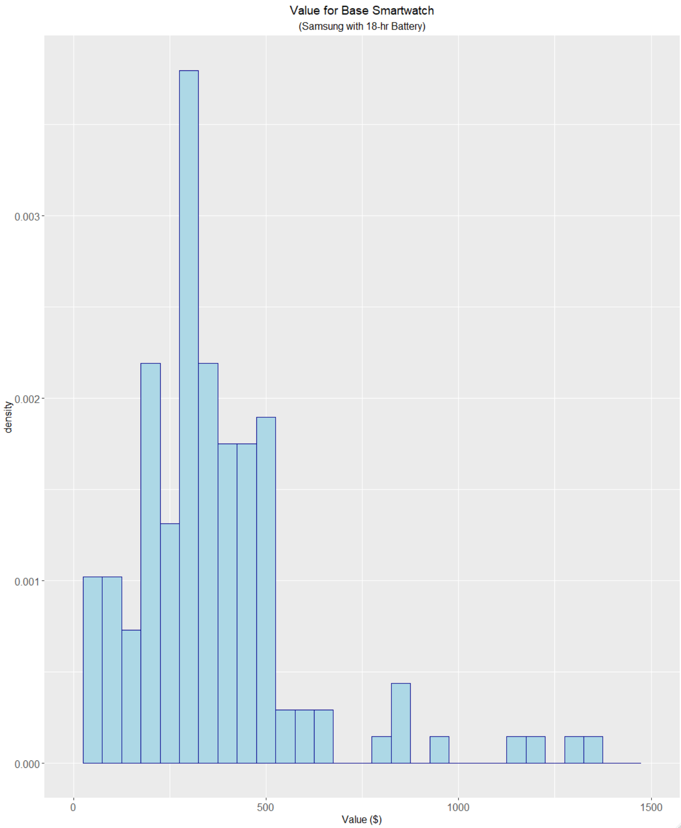
Step 3: Analysis Willingness to pay for Base Watch
This is the value consumers get from the base smartwatch in the study (i.e., Samsung with 18-hour battery)

Slide 67

Step 3: Analysis Incremental willingness to pay for Apple Brand
Price premium consumers are willing to pay to change brand from Samsung to Apple
Note: Some consumers prefer Samsung!

Slide 68

Step 3: Analysis Incremental willingness to pay for 3-day Battery
Price premium consumers are willing to pay to change upgrade battery from 18 hours (base value) to 3 days

Slide 69

Step 3: Analysis Demand & Monetization
Set $p$ to maximize: $\left(p−136\right)\hat{Q\left(p\right)}$
where
Demand estimate
Total unit cost is $136
Source: Apple Watch Series 6 Costs a Measly $136 to Make, With the SoC, Memory, Taking up the Majority of the Bill

Slide 70
Step 3: Analysis Demand & Monetization
Now let’s look at demand for the specific Apple model the client wants to launch given the competitors actually in the market
Apple | Samsung Price = $230 | Fitbit Price = $260
18 hour battery | 1-day battery | 5-day battery
Cellular Service | Cellular Service | Cellular Service
Always-on | Always-on | Always-on
Temperature Sensor |  | Temperature Sensor
Car Crash Detection

Slide 71

Step 3: Analysis Demand
Demand based on availability of Fitbit and Samsung watches

Slide 72
Step 3: Analysis Profit & Optimal Pricing

Slide 73
Inflation & variable cost pass-through Recall Apple Smartwatch conjoint
Marginal cost: $136
New marginal cost: $163

Slide 74
Step 4: Cost pass-through
Suppose silicon chip price inflation since 2020 has driven everyone’cost up 20% to $163
e.g., “A scarcity of chips feeds frustration, inflation,” by Michael Liedtke & Matt O'brien, AP News
Suppose Samsung and Fitbit pass through all the cost inflation.
This will shift Apple demand out!

Slide 75
Step 3: Analysis Demand before vs after competitors raise prices

Slide 76
Step 3: Analysis Profit before vs after competitors raise prices

